Slide 1
Vacuum Cleaner with steamer
Richard Lu

Slide 2
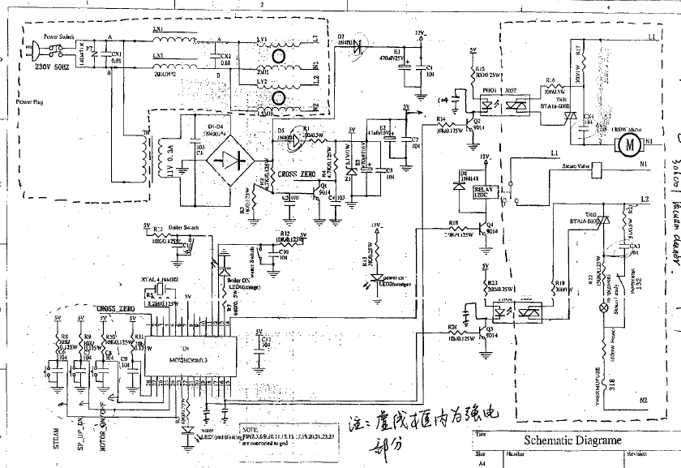
Circuit diagram

Slide 3
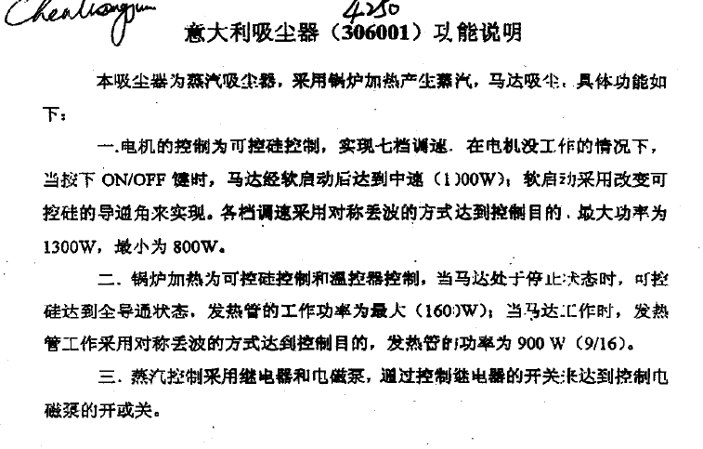
Circuit Principle Summary

Slide 4
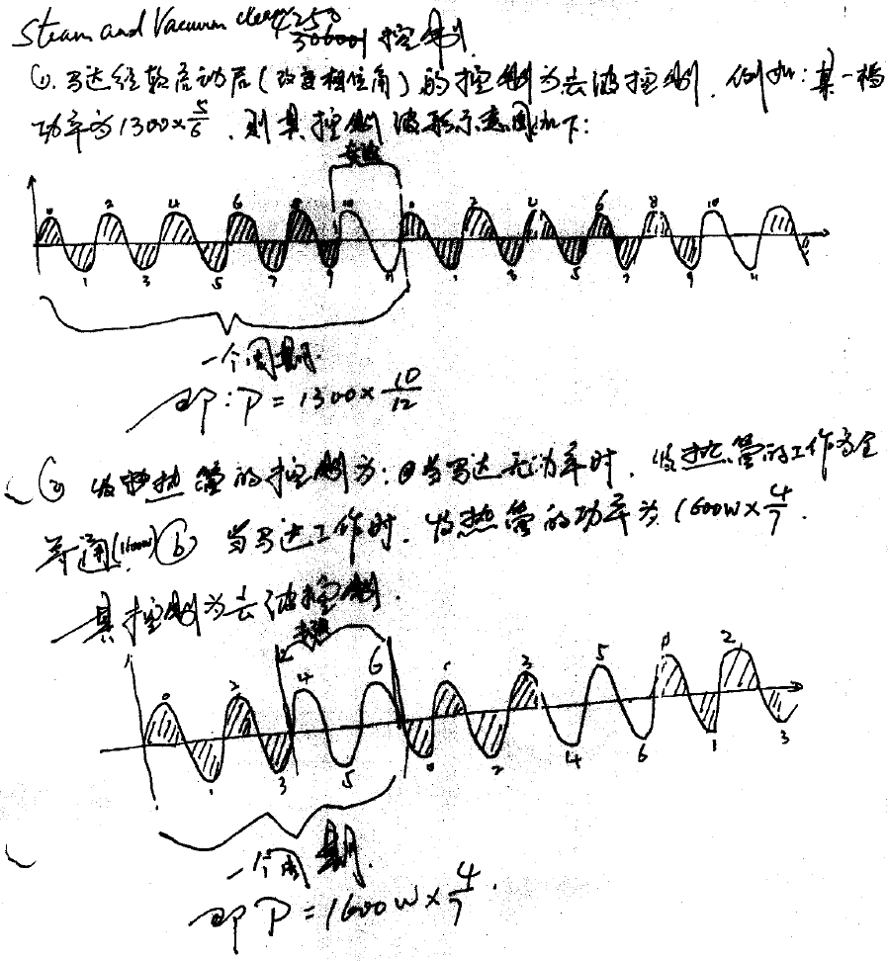
Circuit Principle Summary

Slide 5
Disturbance Source
Motor
TRIAC controlling the heater
TRIAC controlling the motor
Thermostat
IC and Crystal

Slide 6
Sensitive components for immunity test
IC
TRIAC

Slide 7
Applicable standards
Nominal household appliance with motor and heater
EN 55014-1
EN 55014-2
EN 61000-3-2
EN 61000-3-11 (EN 61000-3-3)

Slide 8
Test items/operation modes
Disturbance voltage
    Steam, Vacuum plus steam with low, medium and high motor
speeds
Disturbance power
    Since the power control terminal is not longer than 2m, and its plug or socket is special and is not easily replaceable by the user *), according to user manual, this test item was done with the AC Mains.
    *) Remark: According to EN 55014-1:2000+A1+A2, clause 7.3.1.1.3: “ For the frequency range 30MHz to 300MHz the measurement of disturbance power shall be performed with the absorbing clamp(in addition to the measurement at the mains terminals) by replacing the suction hose and its integrated lead but only if the plug or socket is easily replaceable by the user with a flexible cord connected to the terminals on the main and of necessary length having the same number of wires as provided in the originally submitted suction hose.”

Slide 9
Test items/operation modes
Click
    Since the discontinuous interference of TRIAC on or off has been verified in the test item continuous disturbance voltage, and they can be seen that no discontinuous interference beyond limit was got, we can do this test item only in the working status of steam.
Harmonics
    Since the speed control principle of motor of vacuum cleaner is not to use the phase trigger of TRIAC to control the motor speed, is to control TRIAC to be on or off status from time to time to control the motor speed. And the half power of steam is to control TRIAC to be on or off status from time to time. Therefore, the testing status is the highest motor speed while the function of vacuum cleaner is on.
Flicker
    On-off-on(just for vacuum cleaner)
    Steam
    Vacuum plus steam with the highest frequency “on-off” mode

Slide 10
Test items/operation modes
ESD
  On with vacuum and steam
EFT
  Same as ESD
CS
  Same as ESD
Surge
  Same as ESD
Dips
  Same as ESD

